Slide 1
FOODI APP
By Ricky Kabuto, Jack Racer, Daniel Zheng, Ari Jain

Slide 2
WHAT IS FOODI? OBJECTIVE AND SIGNIFICANCE
Motivation - Improve Health, Gym, Gain and Lose Weight
Found a problem
No way to easily track macros in day to day
Solution:
Foodi! Your all-in-one nutrition app!
Premium Membership
Social Media
Meal planning and nutrition is a very well study and integral science to human health and satisfaction, we decided to streamline it.
Notes:
Ricky on this one

Slide 3
WHY AGILE? PICKING A METHODOLOGY
Waterfall is technically a simpler method for a newer company / startup
However, our ideas for Foodi keep changing and evolving
The ability to grow into something more important is what we believe will make Foodi such a success
As we continue to brainstorm and make plans during development, we’d like the flexibility to develop more, re-test more, and add new implementation / updates overtime
Our company has no stakeholders / deadlines that it directly needs to meet yet, so we have the flexibility to deliver the product whenever we feel ready for our completely new customer base
Notes:
Ari does this slide

Slide 4
HOW DO YOU MAKE IT FEASIBLE? MANAGING SCOPE
Our initial vision included various social features such as sharing popular meals, but we determined that these features were not necessary for a minimum viable product.
We decided to allocate only 10 days of development for social features.
We added this time towards the beginning of the development cycle to create a minimum viable set of features, with the option to add more later if necessary.
We chose to postpone a user reward system until later to see if it was really a requirement for user engagement.
Notes:
Jack on this slide

Slide 5
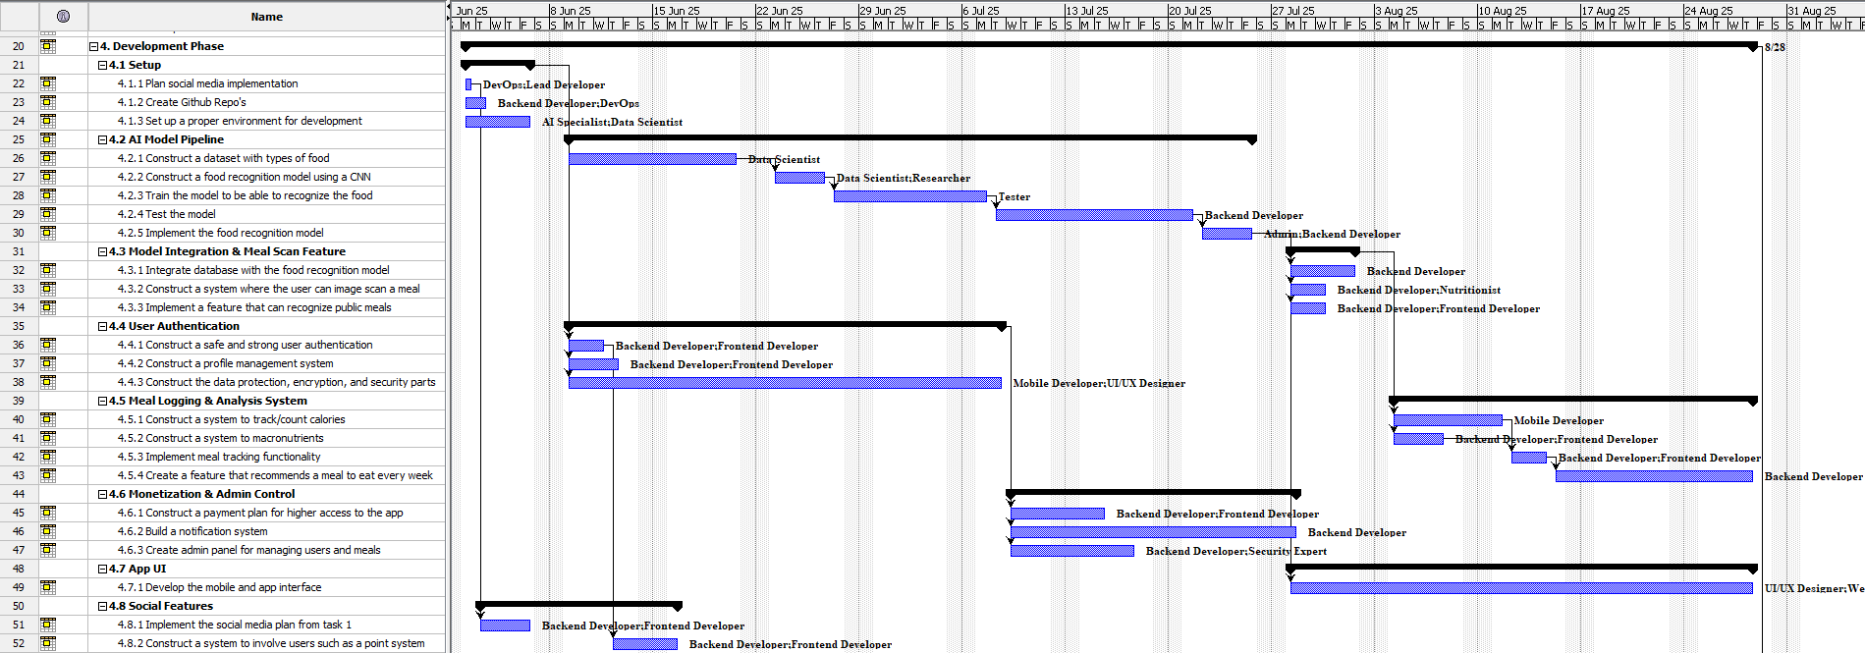
WHAT DID WE LEARN FROM OUR WBS? UNDERSTANDING PROJECT MANAGEMENT
Notes:
Daniel on this slide

Slide 6
WHAT OBSTACLES DID WE FACE? CHALLENGES AND LESSONS
Our biggest challenge was managing scope
Too many big ideas for a startup
Scheduling the Gantt Chart to maximize time and efficiency
How do we make a product profitable?
Realizations about quality assurance, maintenance, and updates
Finally, we needed to assess our risk
Realistically, we’d have a lot of problems and need to make a lot of changes…
Notes:
ricky first
then jack on this slide

Slide 7
HOW DID WE UTILIZE RISK MANAGEMENT? LEARNING FROM PAST MISTAKES
If we did not think about risk management…
The AI training, testing, and development would take way too long
We would have spent money, time, and other resources on advertising and publishing a product without considering maintenance / would’ve had no response to backlash and critics
Because we did…
We have limited / mitigated as much risk of time blockages as possible
We have set aside resources for maintenance costs
Our product has built in longevity!
Notes:
ari does this one

Slide 8

CONCLUSION
Several key decisions
Agile development
Minimal viable product
Food scanner
Parallel task management
Scheduling
Constraints and dependencies
Resource allocation
Time, scope, and cost management
https://youtu.be/H7sKlGcPtHk?si=7OW0_rqUYsn6-f33
Notes:
Daniel can do this one?

